Slide 1
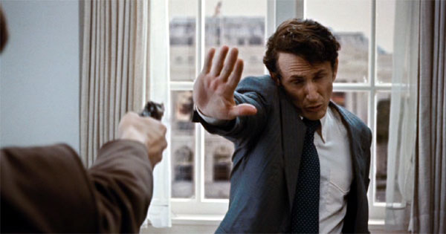

Milk
Rick Warren

Slide 2
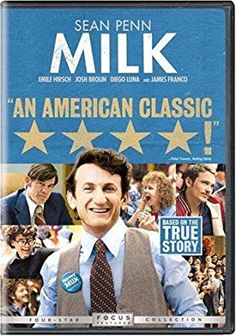
Synopsis
Director Gus Van Sant
Release Date: October 28th, 2008
Other Popular Works of Gus: Goodwill Hunting, My Own Private Idaho, Drugstore Cowboy and To Die For
Main Actors: Sean Penn, James Franco, Josh Brolin, Diego Luna

Slide 3
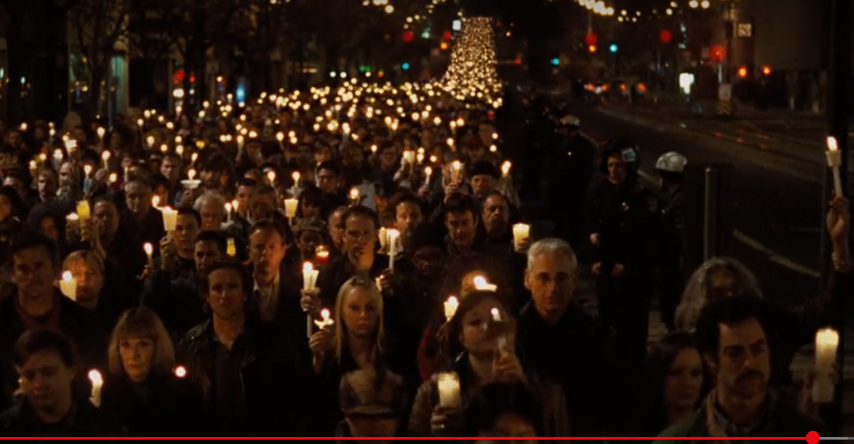
Mise en Scene
Right after the most emotional scene in the movie, the audience has to accept the fact that Harvey is dead.
The scene is set with ‘Rack Focusing, Scene and Set-Up’. These allow the viewers to see the depth of the crowd, the darkness illuminated with the vigil candles, and the crowds faces portray sadness.

Slide 4
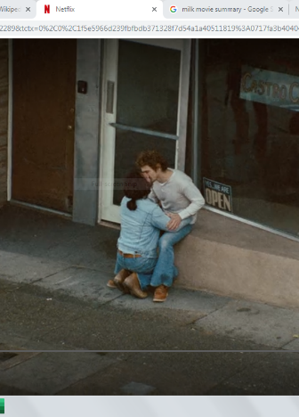
High Angle Shot
The owner of the liquor store came over to give them a ‘warm welcome’ as they just officially opened Castro Cameras.
As they were kissing, the camera zoomed out, and a pedestrian walked by, looking away from them and towards the camera.

Slide 5
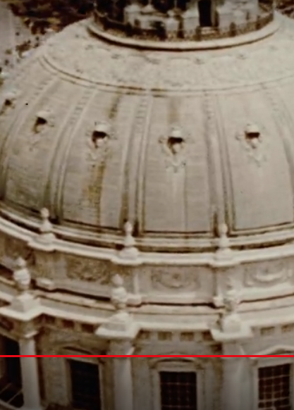
Birds Eye View
This scene is just after Harvey riding in the car before going on the stage for his public address. There was a threat of an assignation, but he proudly accepted the risk and went up.

Slide 6
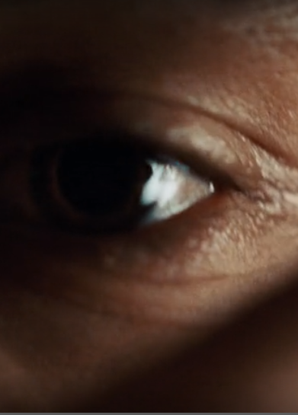
Extreme Close-Up
This scene uses the extreme close-up shot to capture the dynamic between the main character (Harvey) and his first lover (Scott) and it builds this physical and emotional tension we can see throughout the film establishing a relationship from the start

Slide 7
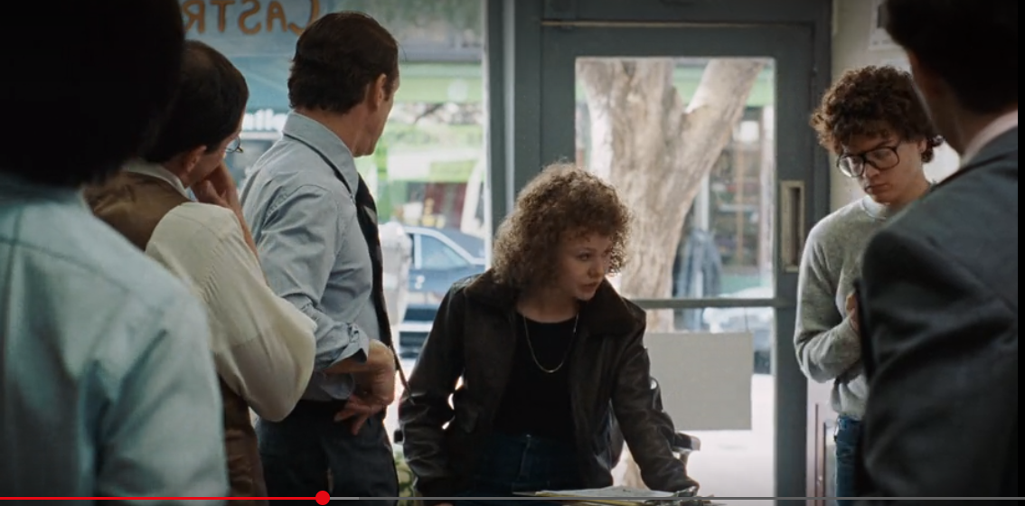
Medium Shot
Harvey Milk had the saying “My name is Harvey Milk and I am here to recruit you’. During the midst of the campaign, the hate mail and everything in between- he’d stay eye level and true to his support system. This scene depicts how much he really values communication and collaboration.

Slide 8
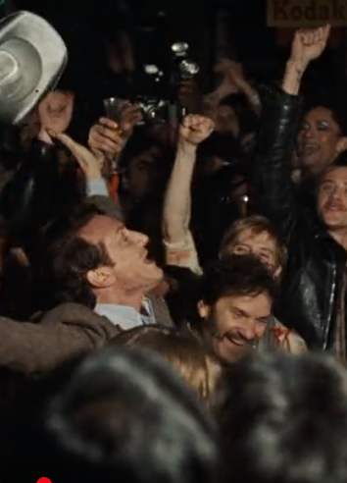
Reaction Shot
As Harvey comes out to approach the crowd on market street, this is a representation of his character. Instead of celebrating with just his colleagues and team, he goes into the street. He is out there to stand along side those who are on his side for the movement, and who are supporting him.

Slide 9
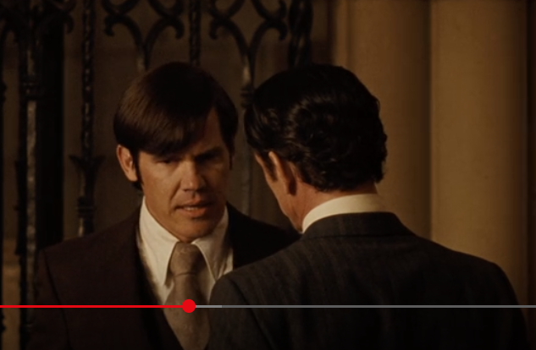
Over-the-shoulder shot
Harvey Milk was invited to the baptism of Dan White’s child, where Harvey was pulled aside, where Dan falsely offers to team up. They were interrupted by his wife, who disapproved of the conversation while in church for a baptism.

Slide 10
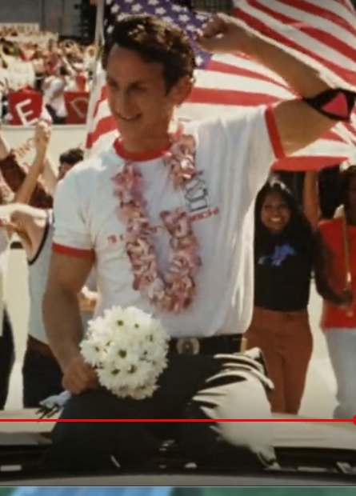
Dolly/ Tracking Shot
To oppose the anti-homosexual teachers' movement, Harvey is front and center during the parade to support those who are gay. Note the American flag is present behind hi, and not the Pride Flag. This demonstrates he stands for more than just the Pride Community, but the nation in its entirety.

Slide 11
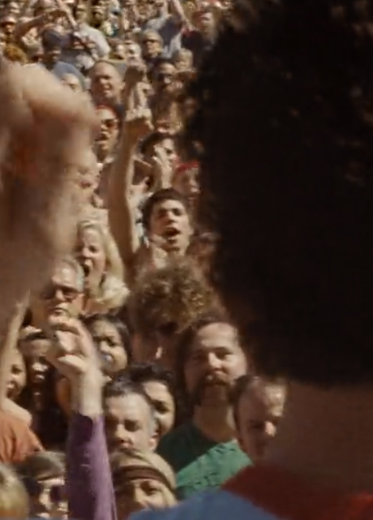
Point-of-View
Harvey during one of arguably his most iconic addresses, is speaking with pure passion, waving his arms and surveying the crowd for a reaction. You can see demonstrators mimicking his hand gestures as he projects a conveying message for his supports.

Slide 12
Thank You!

Slide 13
Works Cited
“Milk.” Milk - Internet Movie Firearms Database - Guns in Movies, TV and Video Games, www.imfdb.org/wiki/Milk.
Black, Dustin Lance. “Milk.” Amazon, Universal Studios, 2009, www.amazon.com/Milk-Sean-Penn/dp/B001QUF3SW.
Film Glossary, www.owlnet.rice.edu/~engl377/film.html.
Sant , Gus V, director. Netflix, Netflix , 2008, www.netflix.com/watch/70100084?trackId=13752289&tctx=0%2C0%2C1f5e5966d239fbfbdb371328f7d54a1a40511819%3A2587392646e5acc92a33c57764a53315da6054a2%2C%2C.

